Slide 1
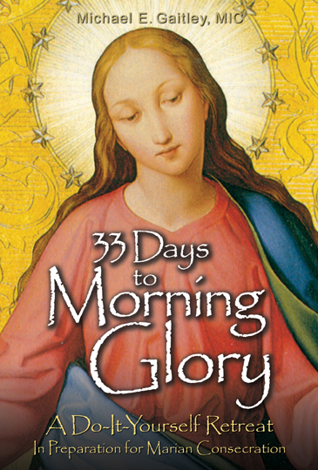

Slide 2
33 DAYS TO
MORNING GLORY
St. John 23 Parish
Hemlock, Merrill and Ryan
Part 1- 33 Days to Morning Glory
Date: April 23, 2017
Time: 5 pm
Part 2 – Consoling the Heart of Jesus
Date: April 23, 2017
Time: 7 pm
Location: Parish Center (Hemlock site)
Notes:
The 33 Days to Morning Glory Program here at [Parish Name] will run from February 22 (Ash Wednesday) until March 26 (the Feast of the Annunciation).

Slide 3
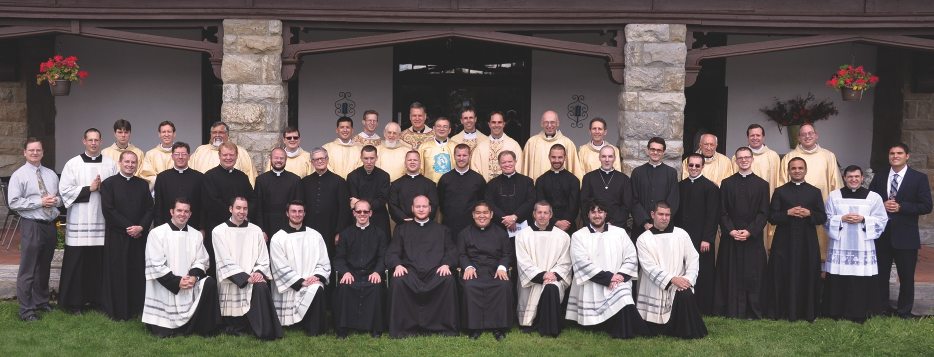
33 DAYS TO MORNING GLORY
Marians Fathers of the
Immaculate Conception of the B.V.M.
Notes:
33 Days to Morning Glory is part of a bigger program brought to us by the Marian Fathers of the Immaculate Conception.
The Marian Fathers of the Immaculate Conception are a Congregation of more than 500 priests and brothers in 20 countries around the world who
* Spread devotion to Mary as the Immaculate Conception
* Pray and intercede for the Holy Souls in Purgatory, especially the victims of war and disease.
* Operate publishing apostolates and assist where the need is greatest in parishes, shrines, schools and missions.
* Promote The Divine Mercy message and devotion.

Slide 4
33 DAYS TO MORNING GLORY
Hearts Afire: Parish-Based Programs
From the Marian Fathers of the Immaculate Conception
Notes:
The Marian Fathers have established the Hearts Afire: Parish-based Programs From the Marian Fathers of the Immaculate Conception to renew the spiritual effort in the life and faith within local churches.

Slide 5
What is
Hearts Afire Parish-based Programs
From the Marian Fathers of the Immaculate Conception?
Notes:
What is Hearts Afire: Parish-based Programs From the Marian Fathers of the Immaculate Conception?

Slide 6
Bold and fresh approach to small group, parish-based, faith renewal programs.
Designed to help us live the complete Catholic life of faith, charity, and the sacraments.
Designed to set our hearts on fire with love of God and neighbor and to inspire us to works of mercy in our families, parishes, and communities.
Notes:
It’s a bold and fresh approach to small group, parish-based, faith renewal programs.
It’s designed to help us live the complete Catholic life of faith, charity, and the sacraments.
It’s designed to set our hearts on fire with love of God and neighbor and to inspire us to works of mercy in our families, parishes, and communities.

Slide 7
HAPP
Hearts Afire: Parish-based Programs
From the Marian Fathers
of the Immaculate Conception
Notes:
A good way to remember Hearts Afire is with the initials H.A.P.P. – HAPP! Hearts Afire Parish-based Programs.

Slide 8
HAPP is a PROGRAM with three STAGES
Stage 1: The Two Hearts
Stage 2: Wisdom and Works of Mercy
Stage 3: Keeping the Hearts Afire
Notes:
In helping parishes with the work of the new evangelization, HAPP is a PROGRAM in three stages:
Stage 1 is the Two Hearts.
Stage 2 is Wisdom and Works of Mercy.
Stage 3 is Keeping the Hearts Afire.

Slide 9
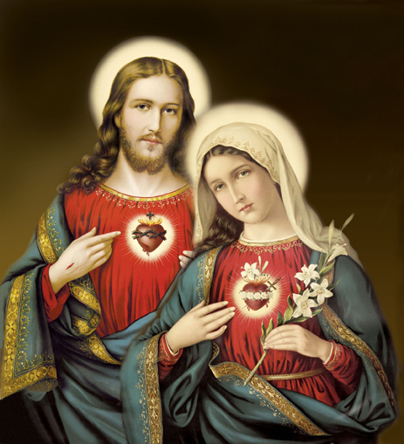
Stage 1: The Two Hearts
Notes:
We all know that people today are living busy and challenging lives. Stage One: The Two Hearts offers people a quick and easy way to withdraw from the demands of life and enter into a peaceful interior reflection on their relationship with Christ. For this reason, the Two Hearts stage is seen as a retreat.

Slide 10
Stage 1: The Two Hearts…
…consists of two parts:
Notes:
In Stage 1, the Two Hearts consist of two parts:

Slide 11
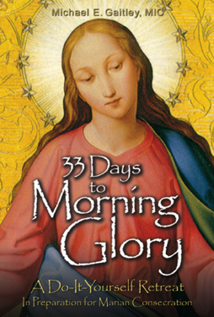
Part 1: The Immaculate Heart
6-week program, 33 Days to Morning Glory Retreat
Includes: 33 Days to Morning
Glory book and DVD talks
Notes:
Part 1 is the Immaculate Heart, which is a 6-week program that uses the 33 Days to Morning Glory Retreat, the pilot program that we will start on INSERT DATE. This part of the program includes the book 33 Days to Morning Glory and its accompanying group-retreat materials, which consist of 6 DVD talks that are 30 minutes in length and a Retreat Companion for each participant.

Slide 12
The Immaculate Heart
The Immaculate Heart of Mary leads us to the Sacred Heart of Jesus.
Notes:
We begin with the Immaculate Heart of Mary, because Mary leads us to the Sacred Heart of Jesus. The goal of this program is to lead us to formally entrust or consecrate ourselves to Mary. Mary then leads us to the Sacred Heart,

Slide 13
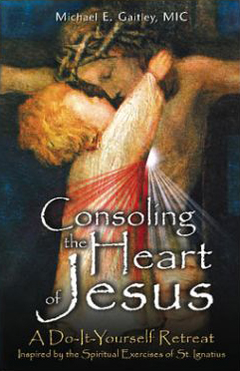
Part 2: The Sacred Heart
10-week program, Consoling the
Heart of Jesus Retreat
Includes: Consoling the
Heart of Jesus book, DVD talks,
Retreat Companion
Notes:
Part 2 is the Sacred Heart, which is an 8-week program that uses the Consoling the Heart of Jesus Retreat, which was also written by Fr. Michael Gaitley, MIC. This program would follow after people have done the 33 Days to Morning Glory Retreat. The Consoling the Heart of Jesus retreat consists of 10 DVD talksthat are 35 minutes in length and a Retreat Companion for each participant. Depending on how our 33 Days to Morning Glory Retreat goes, we hope to follow it up with the Consoling the Heart of Jesus Retreat in the near future.

Slide 14
The Sacred Heart
Consoling the Heart of Jesus
Way to console His heart by accepting His love and trusting in Him completely.
Notes:
which begins the second stage of Stage One with Consoling the Heart of Jesus. The book “Consoling the Heart of Jesus” gives us an awareness of God’s infinite mercy and how we can give Him joy, showing us the way to console His heart by accepting His love and trusting in Him completely. It also focuses on what to do with the suffering we all encounter, helping us grow spiritually closer to the Sacred Heart of Jesus.

Slide 15
For more information visit:
www.AllHeartsAfire.org
Notes:
Since we don’t want to get ahead of ourselves, I strongly recommend visiting the website for HAPP at www.AllHeartsAfire.org for more information about Stages 2 and 3 of the program. On the website you can also get valuable resources and helpful information as you participate in the 33 Days to Morning Glory Retreat.

Slide 16
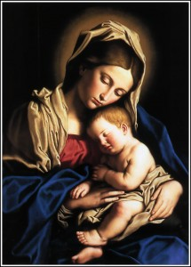
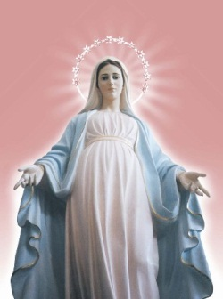
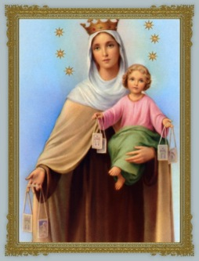
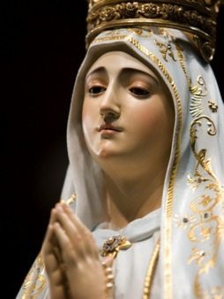
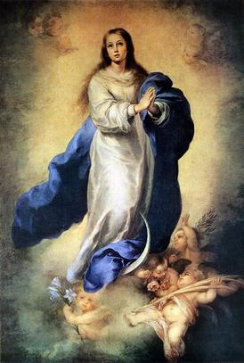
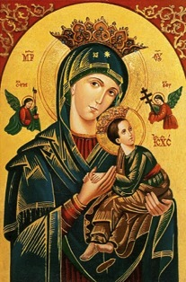
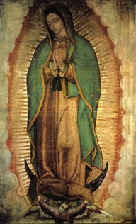
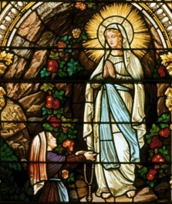
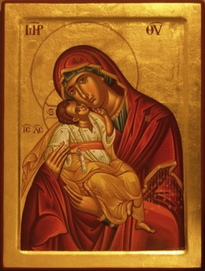
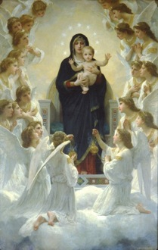
WHAT IS A MARIAN CONSECRATION?
Notes:
Now we will move on to what is a Marian consecration? Just by a show of hands, how many of you here have done a Marian consecration before, as recommended either by St. Louis de Montfort or St. Maximilian Kolbe? The good thing about doing a Marian consecration is that you don’t only have to do it once, you can keep renewing it.

Slide 17
MARIAN CONSECRATION
Means giving Mary permission to complete her motherly role in our spiritual lives of helping us to great holiness in her Son, Jesus.
It means saying to Mary: “Mary, I want to be a saint. I know that you also want me to be a saint and that it’s your God-given mission to form me into one. So, Mary, at this moment, on this day, I freely choose to give you my full permission to do your work in me, with your Spouse, the Holy Spirit.”
Notes:
So for those who may not understand what a Marian consecration is, let me explain what it’s all about. (This explanation, by the way, comes from Fr. Michael Gaitley, MIC.) Marian consecration basically means giving Mary our full permission (or as much permission as we can) to complete her motherly task in us, which is to form us into other Christs.
And so, by consecrating ourselves to Mary, each of us is saying to her: “Mary, I want to be a saint. I know that you also want me to be a saint and that it’s your God-given mission to form me into one. So, Mary, at this moment, on this day, I freely choose to give you my full permission to do your work in me, with your Spouse, the Holy Spirit.”

Slide 18
MARIAN CONSECRATION
Mary is such a gentle mother.
She makes the lessons of the Cross into something sweet.
She pours her motherly love and solace into our every wound.
Going to her is the “surest, easiest, shortest and the most perfect means” to becoming saint.
Notes:
Now, one of the greatest aspects of being consecrated to Mary is that she’s such a gentle mother. She makes the lessons of the Cross into something sweet, and she pours her motherly love and solace into our every wound. Going to her and giving her permission to do her job is the “surest, easiest, shortest and the most perfect means” to becoming a saint.

Slide 19
CONSECRATED TO JESUS THROUGH MARY!
Notes:
What a joy it is then to be consecrated to Jesus through Mary!

Slide 20
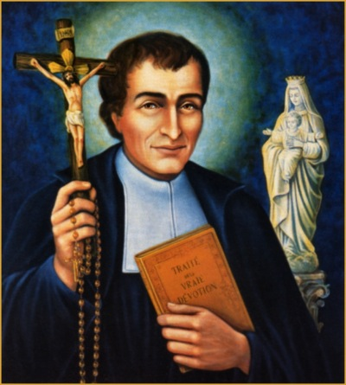
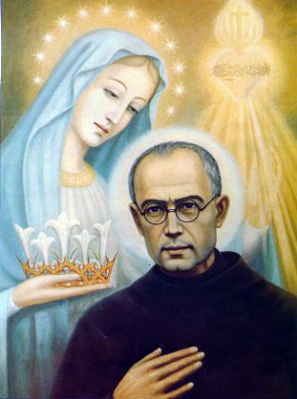
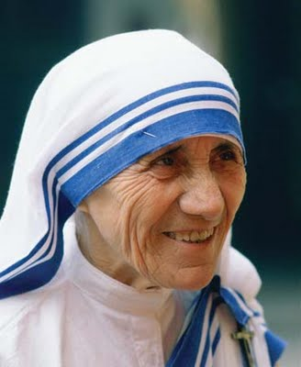
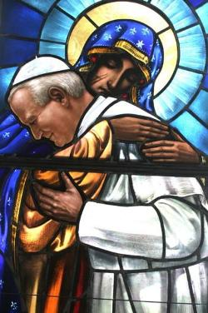
33 DAYS TO MORNING GLORY
33-day journey to consecration to Mary, using the spiritual wisdom of four giants of Marian spirituality.
St. Louis de Monfort
St. Maximilian Kolbe
St. Teresa of Calcutta
St. John Paul II
Notes:
33 Days to Morning Glory is a 33-day journey to consecration to Mary, using the spiritual wisdom of four giants of Marian spirituality: St. Louis de Montfort, St. Maximilian Kolbe, St. Teresa of Calcutta, and Blessed Pope John Paul II.

Slide 21
33 DAYS TO MORNING GLORY
33-day preparation for Marian consecration.
Each day we’ll follow the four great Marian giants who will teach us the secrets of drawing closer to the Heart of Jesus through the Heart of Mary.
Each week we’ll meet as a large group, break off into our small groups, and then watch a 30-minute video by Fr. Michael Gaitley, MIC.
Notes:
Starting on February 22 (Ash Wednesday), we will begin our 33-day preparation for Marian consecration. Using the “33 Days to Morning Glory” book, each day we’ll individually follow the four great Marian giants I just mentioned and they’ll teach us the secrets of drawing closer to the Heart of Jesus through the Heart of Mary. Each week we’ll be meeting as a large group and then breaking off into our small groups and then watch a 30-minute video presented by Fr. Michael Gaitley, MIC.

Slide 22
33 DAYS TO MORNING GLORY
Each meeting will be an hour and a half.
Large group discussion
Introduction video
Small group discussion
Main video

